Slide 1

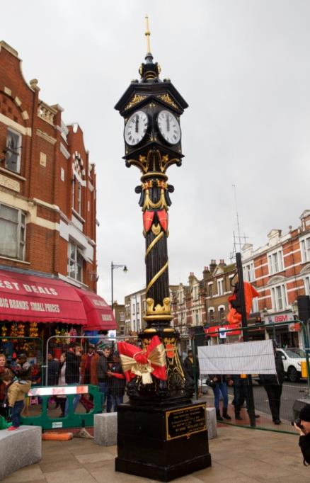

NO BASS LIKE HOME

