Slide 1
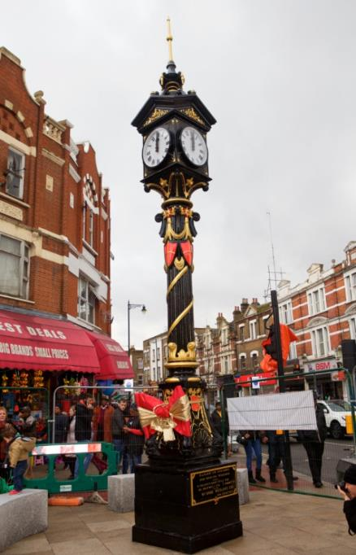
NO BASS LIKE HOME

